Slide 1
Institute Of Engineering & Technology Khandari Campus, Agra
1
Department Of Computer Secience & Engineering

Slide 2
MAJOR PROJECT PRESENTATION
Project Name: Real Time Human Pose Estimation
Project Members Name
Ravi Kumar Gupt 1909005371037
Riya
Dixit 1909005371041
Rishabh Kumar Singh 1909005371039

Slide 3
INDEX
S.No | Topics | Page No
1. | Constraints | 4
2. | Introduction | 5
3. | Pose Estimation | 6
4. | Types Of Pose Estimation | 7 - 9
5. | Libraries | 10 - 13
6. | Flow of Project | 14 - 15
7. | Website Home Page | 16
8. | Use Cases | 17
9. | The Future Scope | 18
10. | Conclusion | 19

Slide 4
CONSTRAINTS
Pose estimation is a vast topic and considering their types (2D pose estimation and 3D pose estimation) we had restricted our project to the 2D pose estimation which is the estimation of keypoints of object or image along x and y coordinate.
On the other hand the implementation can be done in several ways. But we will estimate the single and multi pose with the help of Browser.
Here we are not going to train the Machine Learning models, instead we had used java script libraries which have inbuilt capabilities of Machine Learning and just by using some import commands we will have access to those Machine Learning models.

Slide 5
INTRODUCTION
5
The Human Pose Estimation is the task of using a machine learning model to estimate the approximate pose of a person from an image or a video by estimating the spatial locations of key body joints that is called keypoints.
The Aim of this project is to deliver the basic use cases of the Pose Net model for real-time human pose estimation using a webcam feed as the data.
TensorFlow.js is a JavaScript library that enables the training and deployment of machine learning models in the browser.

Slide 6
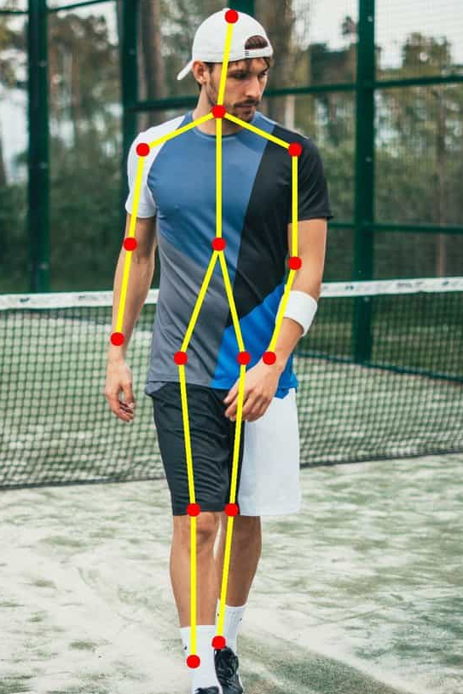
POSE ESTIMATION
Definition: Real-time human pose estimation is a technique that involves detecting and tracking human body parts in real-time video or image data.
Explanation: Real-time human pose estimation uses computer vision and machine learning techniques to identify the location and orientation of each body part.
Use cases: Human action recognition, human-computer interaction, video surveillance, fitness, health tracking, and gesture recognition.

Slide 7
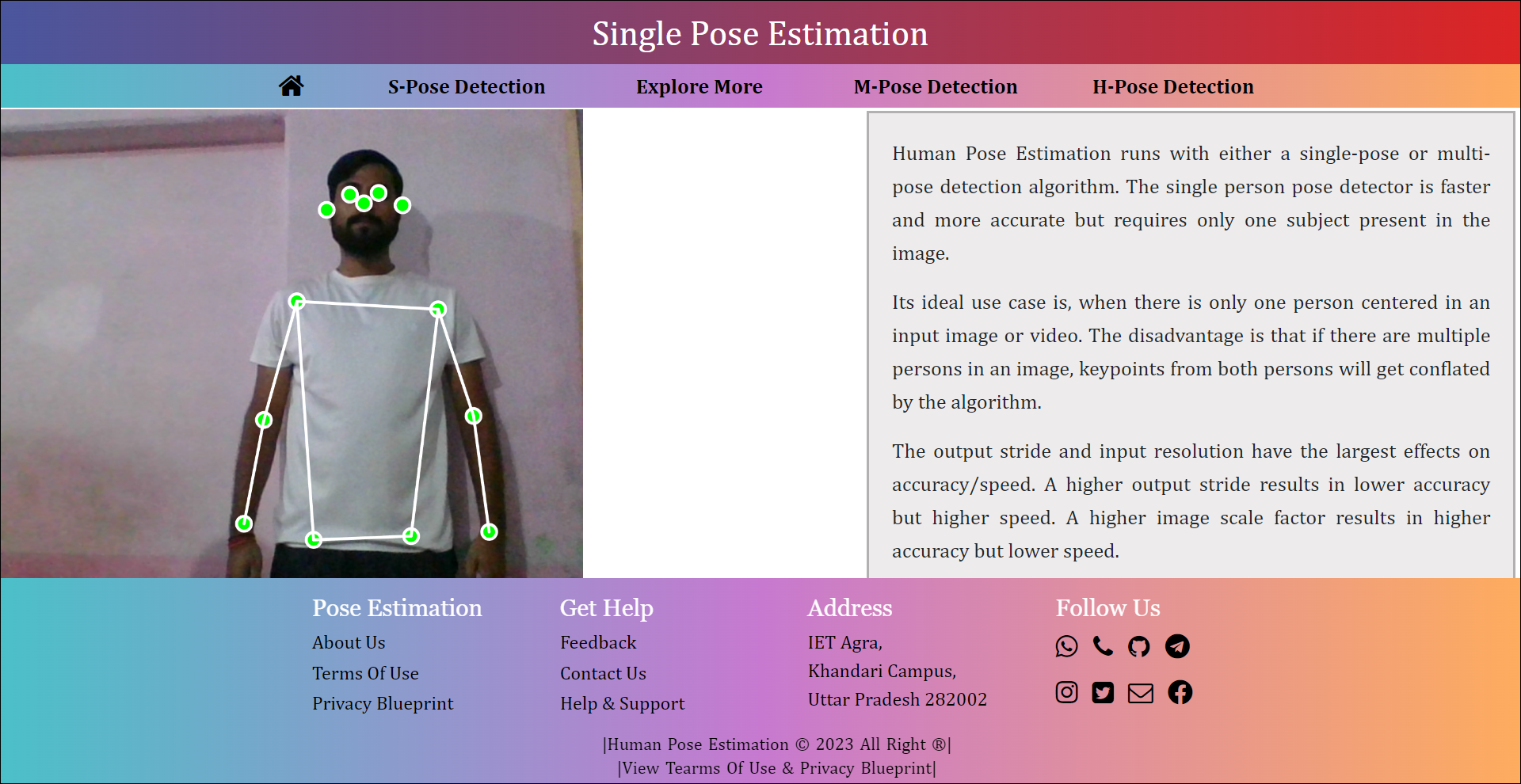
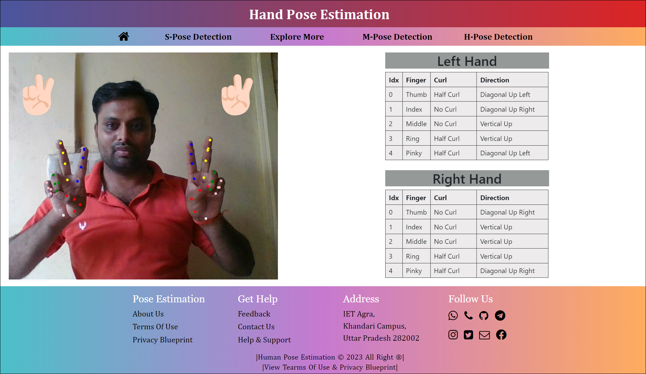
TYPES OF POSE ESTIMATION
7

Slide 8
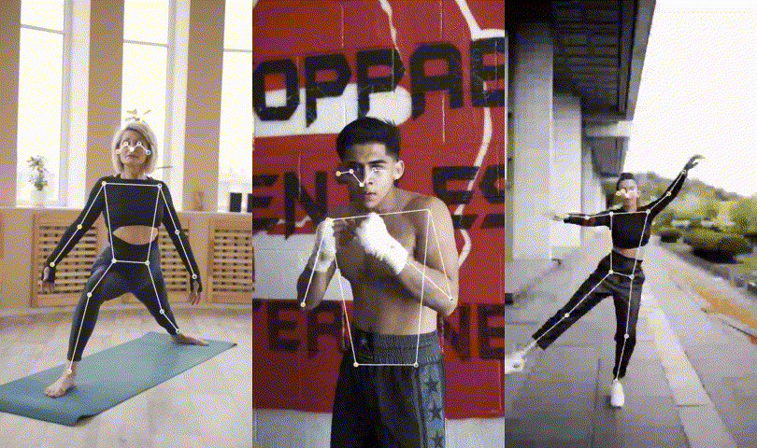
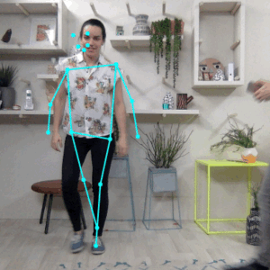
SINGLE POSE ESTIMATION
MULTI POSE ESTIMATION
Pose Estimation can estimate either a single pose or multiple poses, meaning there is a version of the algorithm that can detect only one person in an image/video and one version that can detect multiple persons in an image/video.

Slide 9
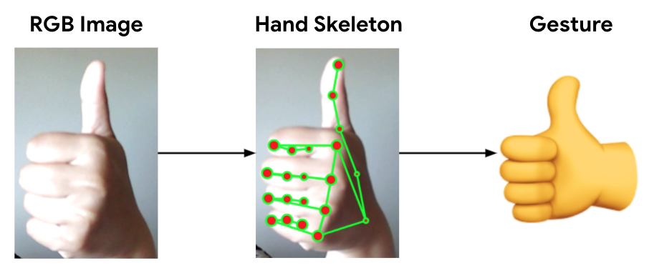
HAND POSE ESTIMATION
9
Hand pose estimation refers to the task of detecting and localizing the key points (joints) of a human hand in an image or video. These key points usually correspond to the positions of the fingertips, knuckles, and wrist.
Hand pose estimation can have various applications, including gesture recognition, sign language translation, human-computer interaction, and virtual reality.

Slide 10
LIBRARIES
Following are the libraries that we had used to implement the real time human pose estimation project in web browser.
TensorFlow
Ml5.js
P5.js

Slide 11
1. Tensor Flow
Definition: TensorFlow.js is a JavaScript library that enables the training and deployment of machine learning models on the browser and Node.js.
Overview of features: It allows developers to use high-level APIs and pre-trained models, run models in the browser, and create interactive applications with machine learning capabilities.
Advantages: TensorFlow.js also enables real-time inference and processing of data, reducing the latency and bandwidth requirements of traditional machine learning applications.

Slide 12
2. Ml5.Js
Definition: ml5.js is a machine learning library for creative coding that provides easy-to-use APIs for developers to implement machine learning models in their web-based projects.
Overview of features: ml5.js provides a range of pre-trained machine learning models, including image and audio recognition, natural language processing, and generative models.
Advantages: It have a large community of developers , simplifies the implementation of machine learning in creative coding projects, compatible with multiple web browsers and can be used on different platforms, including desktop and mobile.

Slide 13
3. P5.Js
Definition: p5.js is a simple and accessible approach to creating interactive graphics, animations, and media in web browsers.
Overview of features: p5.js provides a range of drawing and animation tools, including 2D and 3D rendering, sound and video input/output, and interactivity with mouse and keyboard events.
Advantages: p5.js is easy to learn and use, making it accessible to a broad range of developers, including beginners, artists, designers, and educators. It is open source and well-documented, with an active community of contributors, making it continually evolving and improving.

Slide 14
FLOW OF THE PROJECT
Data Collection And Data Preprocessing: Since we are using the pretrained machine learning model data collection & preprocessing is managed by tensorflow.js.
Model Selection: TensorFlow.js provides several pre-trained models for this task, including PoseNet and BlazePose.
Integration with Web Browser: This involves loading the model into the browser and configuring it to run on the user's device.
User Input: The user provides an image or a video stream to the web application, which is then used as input to the human pose estimation model.

Slide 15
Inference: The model processes the input image or video stream and predicts the joint positions of the human body.
Visualization: The predicted joint positions are visualized on the input image or video stream in real-time.
Optimization: The model hyperparameters can be fine-tuned to improve its performance on the user's device.
Testing: The web application is tested on different devices and under different conditions to evaluate its performance and ensure that it works correctly.
Deployment: The final step is to deploy the web application, where it can be used by the users to estimate human poses in real-time.

Slide 16
WEBSITE HOME PAGE

Slide 17
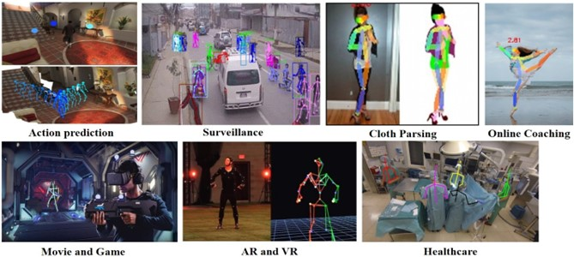
USE CASES

Slide 18
THE FUTURE SCOPE
18
Real-Time Pose Estimation on Edge Devices: Optimize the model to run efficiently on edge devices.
Privacy and Security Considerations: Address privacy concerns related to pose estimation.
Real-Time Feedback and Coaching: Provide real-time feedback and coaching based on detected poses.
Collaborative Pose Estimation: Investigate methods for collaborative pose estimation using multiple devices.
Self-Supervised Learning: Explore self-supervised learning techniques for pose estimation.
Virtual Try-On and Fashion: Utilize pose estimation for virtual try-on applications.
3D Pose Estimation: Enhance the model to estimate three-dimensional poses of humans.

Slide 19
CONCLUSION
The aim is to deliver the basic use cases of the Pose Net model for real-time human pose estimation using a webcam feed as the data. Now, the challenge is to create an advanced webcam filter that has the detection functionalities like the Snapchat camera.
Real-time human pose estimation is a developing field that uses computer vision algorithms and machine learning models to estimate the position and orientation of a person's joints in real-time. It has applications in various fields, including virtual reality, gaming, sports analytics, and health monitoring.

Slide 20
20
RELATED LINKS
Figma Design
https://www.figma.com/proto/IwBTcGW9T4qGUhQMAbepp8/Human-Pose-Estimation?node-id=210%3A67&scaling=contain&page-id=0%3A1
Source Code Is Pushed To GitHub https://github.com/itsindrajput/PoseEstimation.git
Our Pose Estimation Website
https://poseestimation.netlify.app

Slide 21
21
Thank
You

